Slide 1


Common-Mode fundamentals for
Shipboard Power Systems
Part 7
Impact of Frequency on CM Choke performance
Dr. Norbert Doerry
Dr. John Amy
http://doerry.org/norbert/MarineElectricalPowerSystems/index.htm
© 2025 by Norbert Doerry and John Amy
This work is licensed via: CC BY 4.0 (https://creativecommons.org/)

Slide 2
Impact of Frequency on CM Choke Performance
Will use same circuit from Part 6, will only use 120° Mode
Part 6 inverter created waveform with a 12 ms period
This presentation will examine waveforms where the inverters are configured to produce ac voltages with various periods
  9 ms (111 Hz)
  12 ms (83 Hz)
  36 ms (28 Hz)
  120 ms (8.3 Hz)

Slide 3
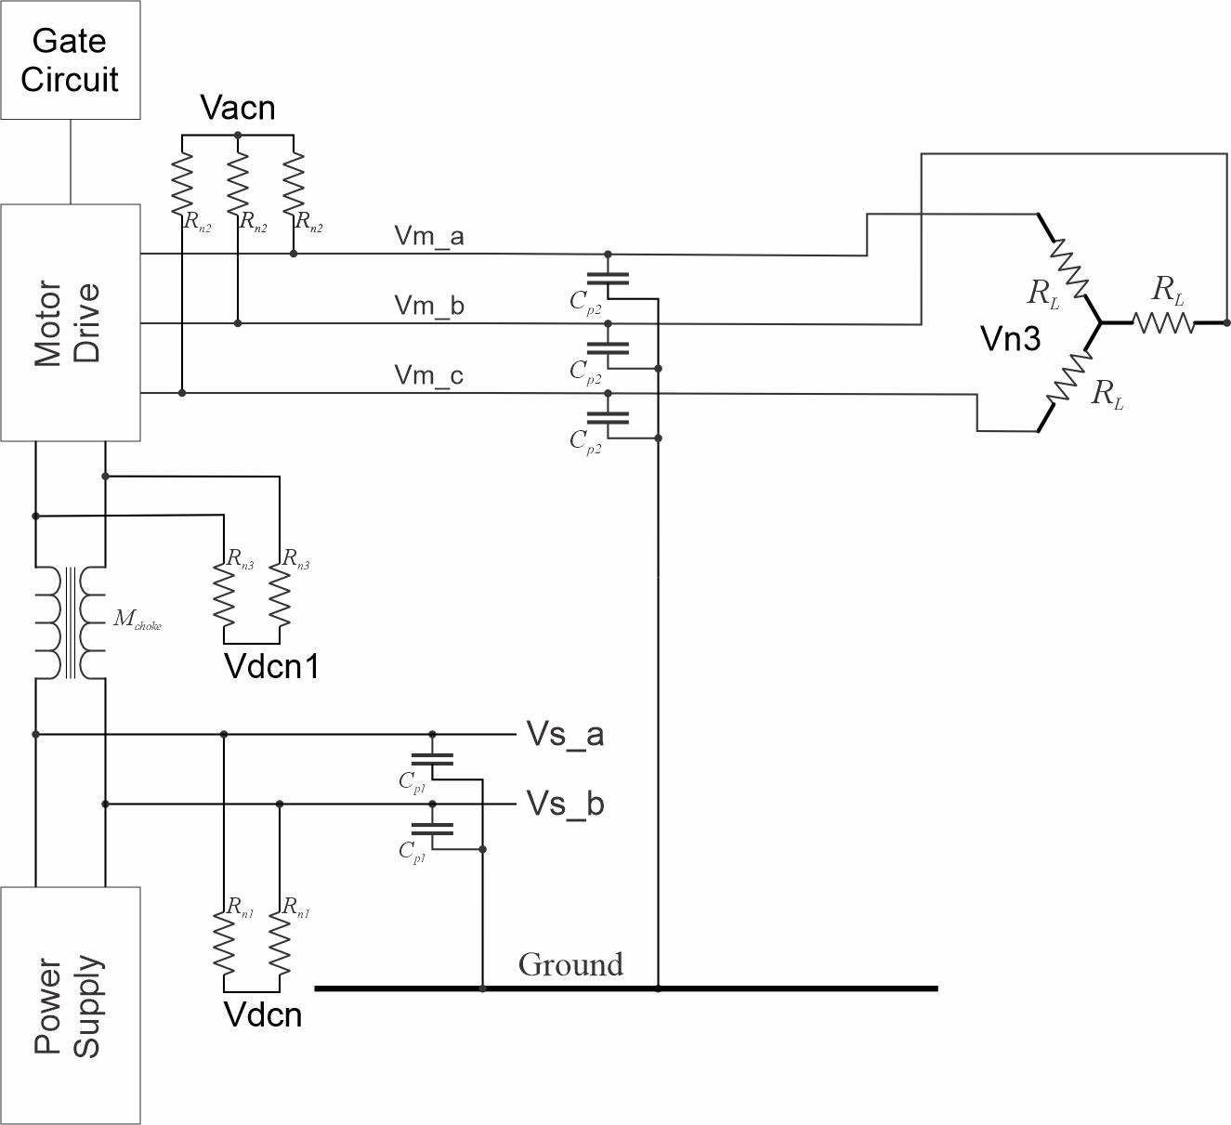
Example Power Electronic Circuit
Control Input 1
C_{p1} = 2.2 µF
C_{p2} = 2.2 µF
R_{n1} = 1200 Ω
R_{n2} = 1200 Ω
R_{n3} = 1200 Ω
R_{L} = 300 Ω
M_{choke} = 0.2115 H
L_{choke} = 0.2175 H

Slide 4
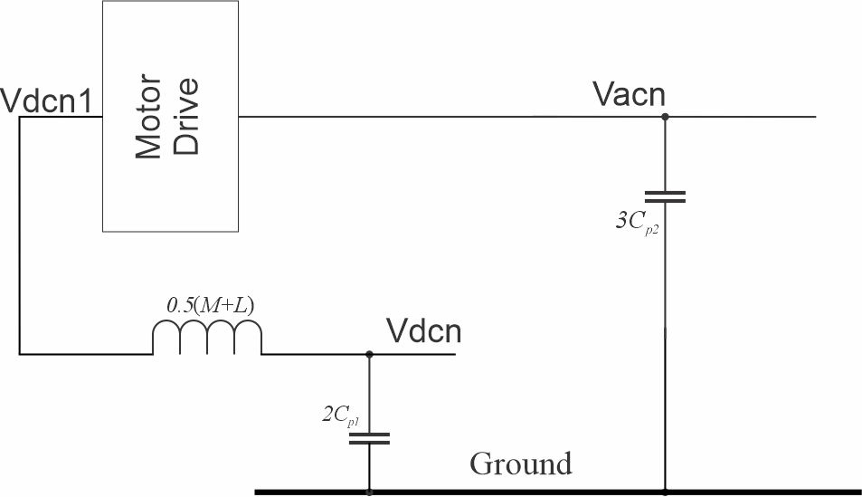
Example Power Electronic Circuit – CM model

Slide 5
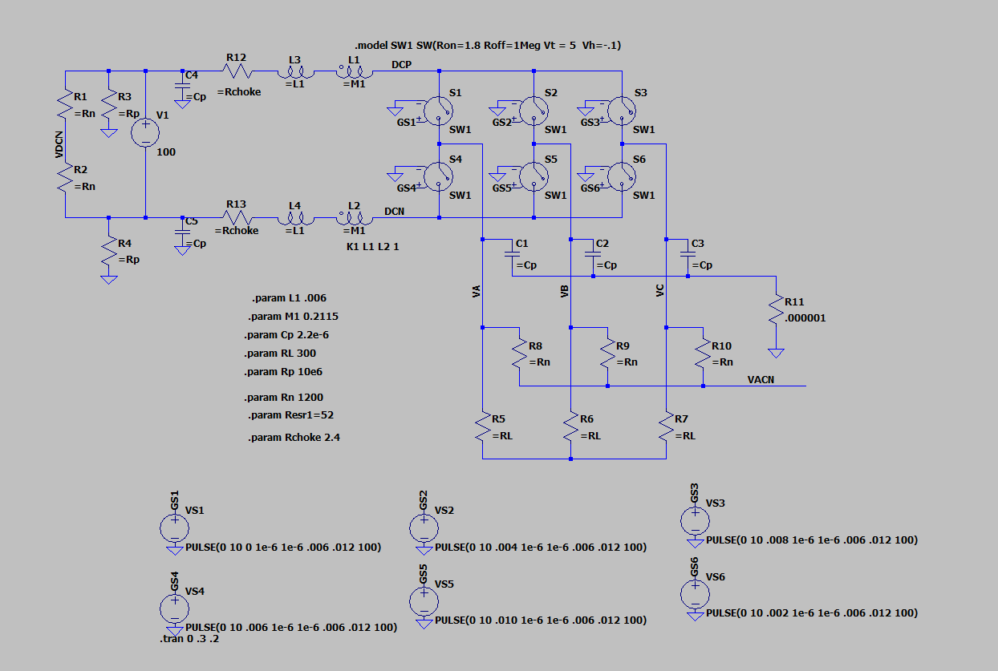
LTSpice Simulation
20250607 Inverter CM xxxms.asc

Slide 6
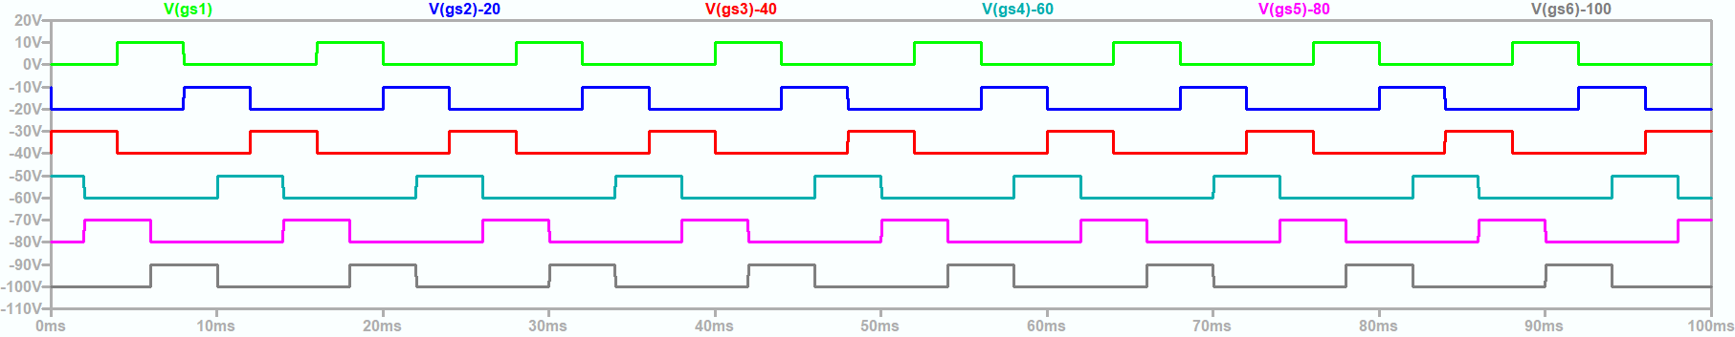
120° Mode modulation scheme
20250607 Inverter CM 12ms.asc

Slide 7
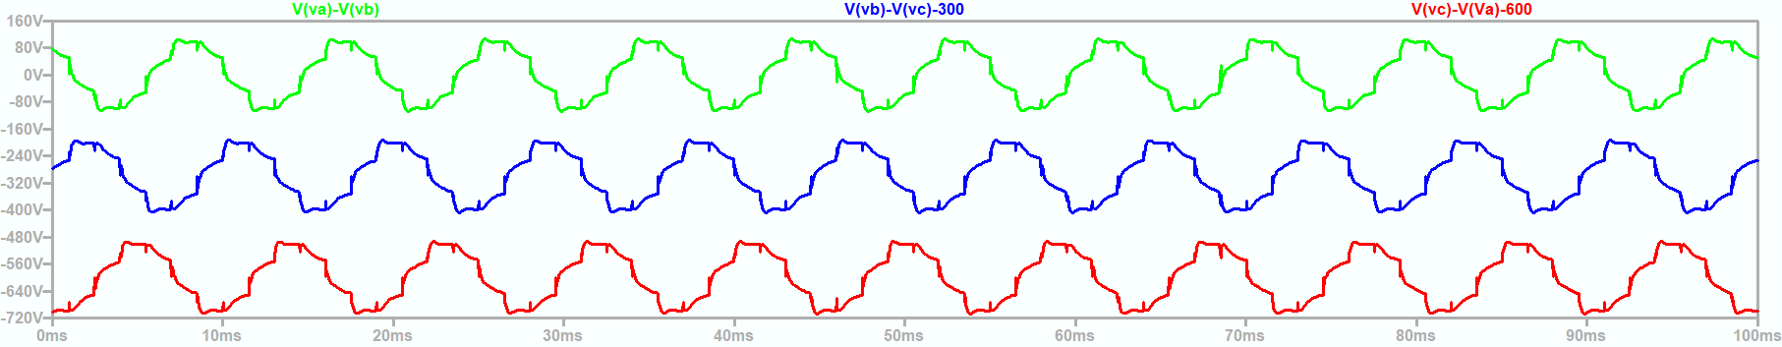
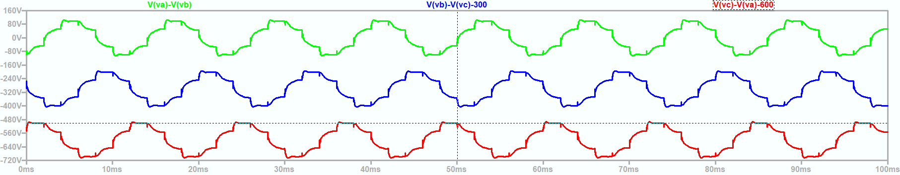
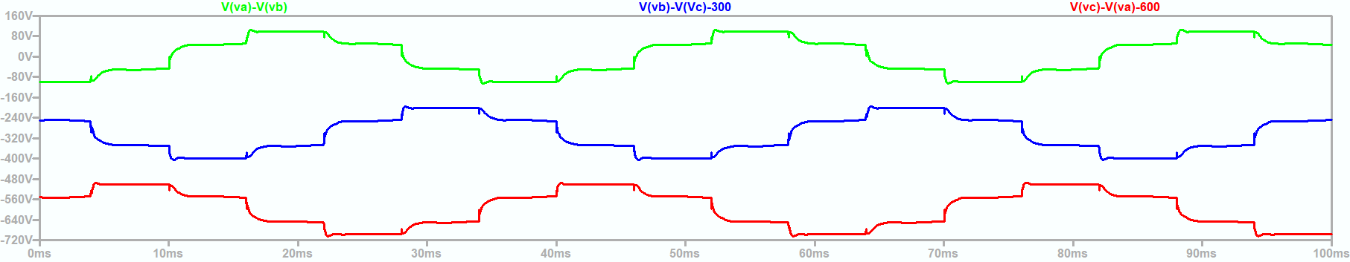
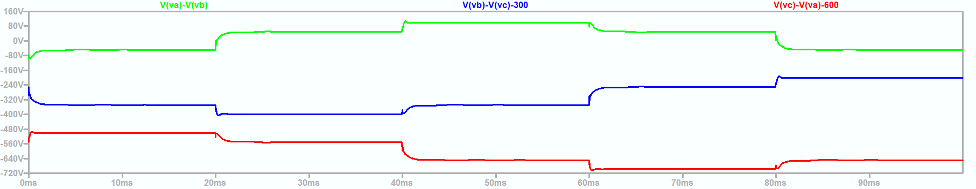
Line to Line Voltages
9 ms
12 ms
36 ms
120 ms
20250607 Inverter CM xxxms.asc

Slide 8
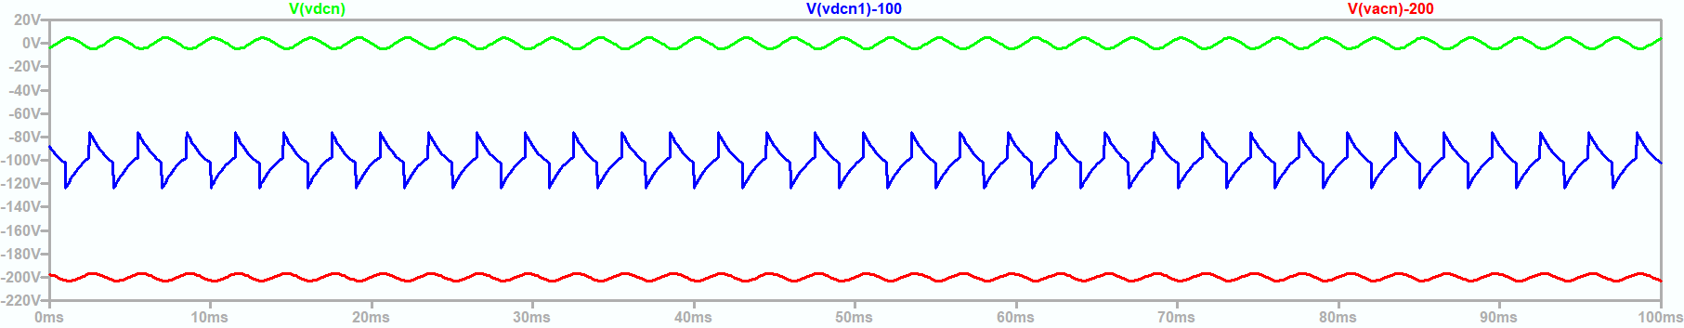
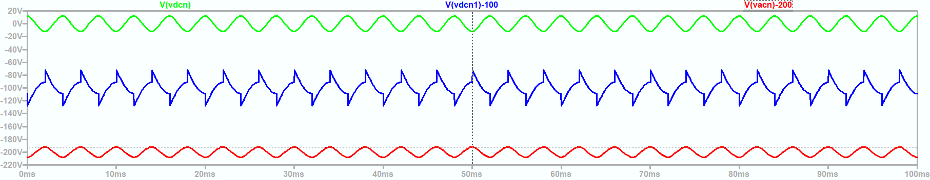
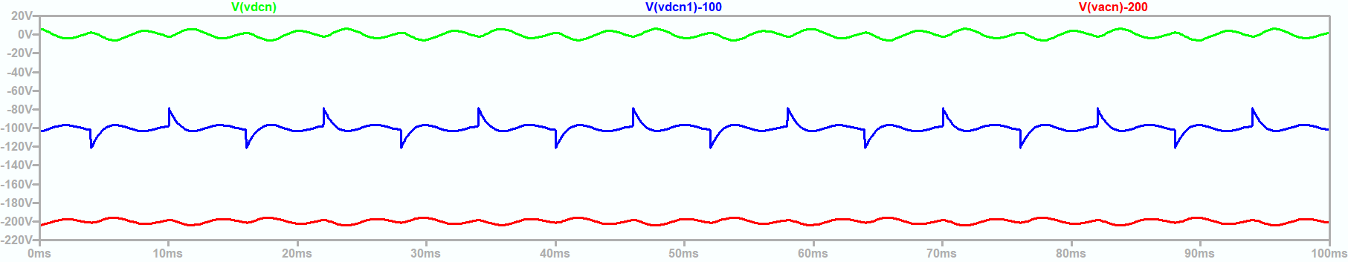
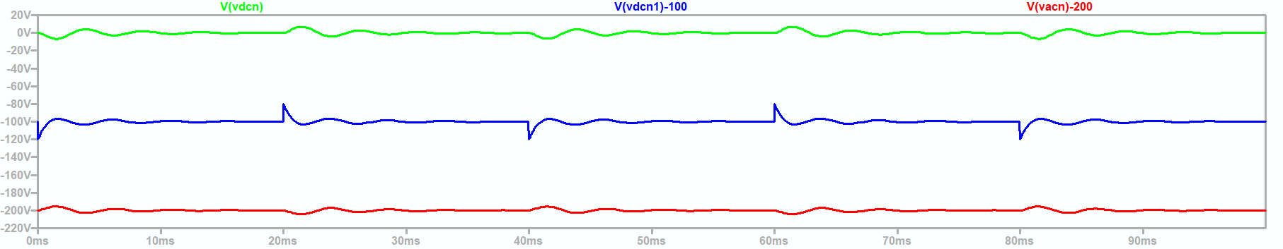
Common Mode Voltages with respect to Ground
9 ms
12 ms
36 ms
120 ms
20250607 Inverter CM xxxms.asc

Slide 9
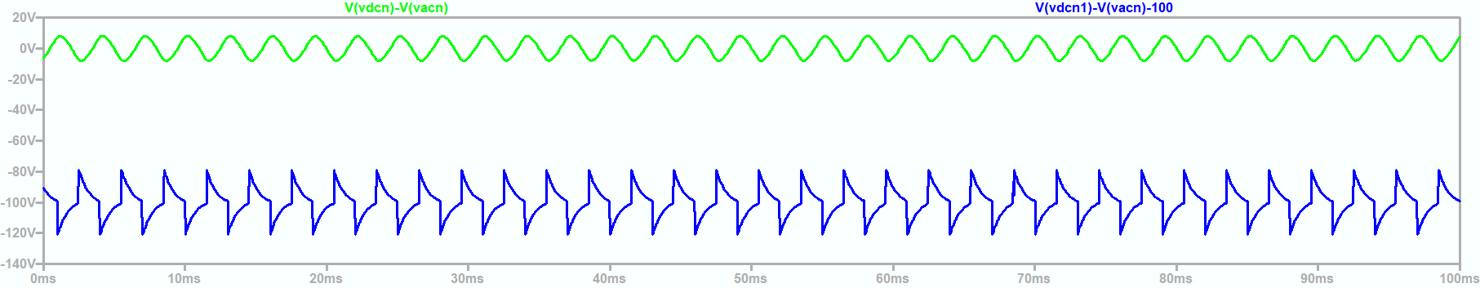
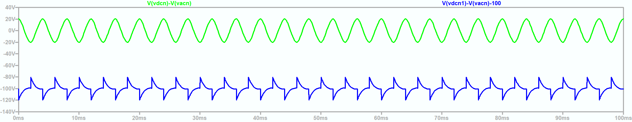
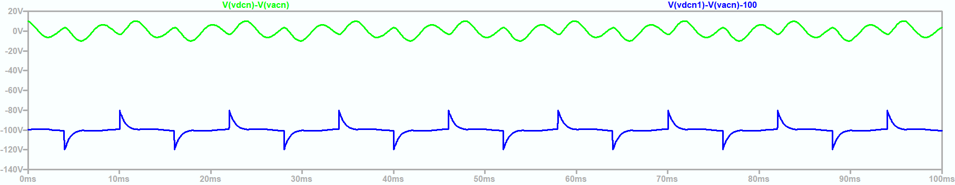
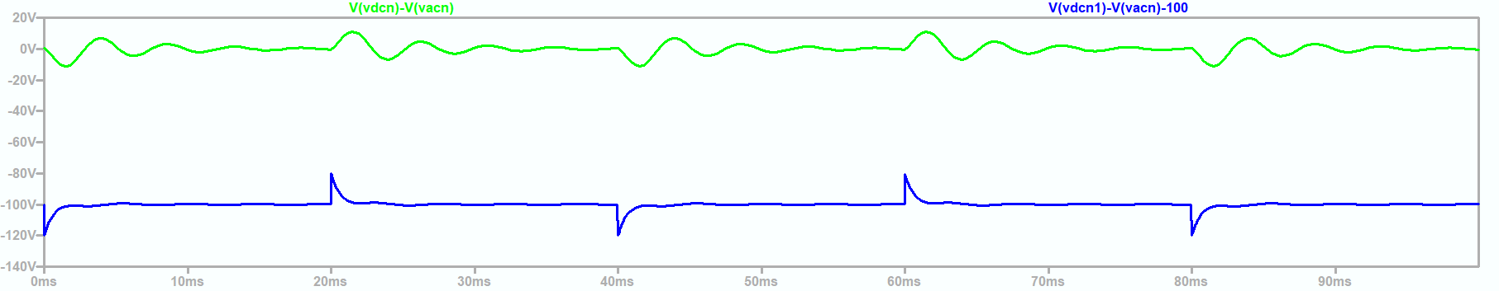
Common Mode Voltages with respect to AC Neutral Voltage
9 ms
12 ms
36 ms
120 ms
20250607 Inverter CM xxxms.asc

Slide 10
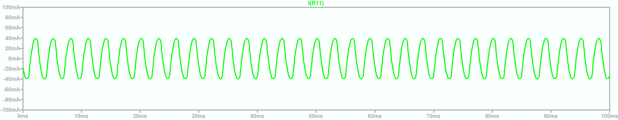
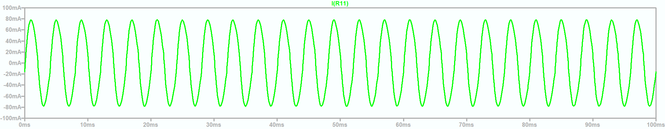
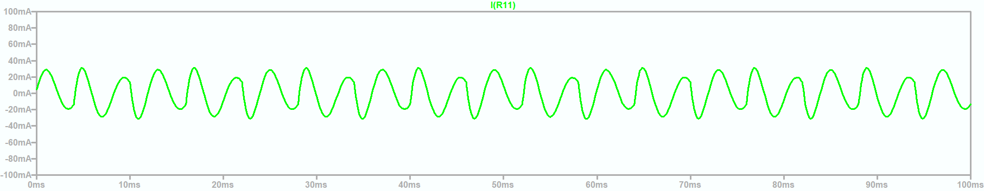
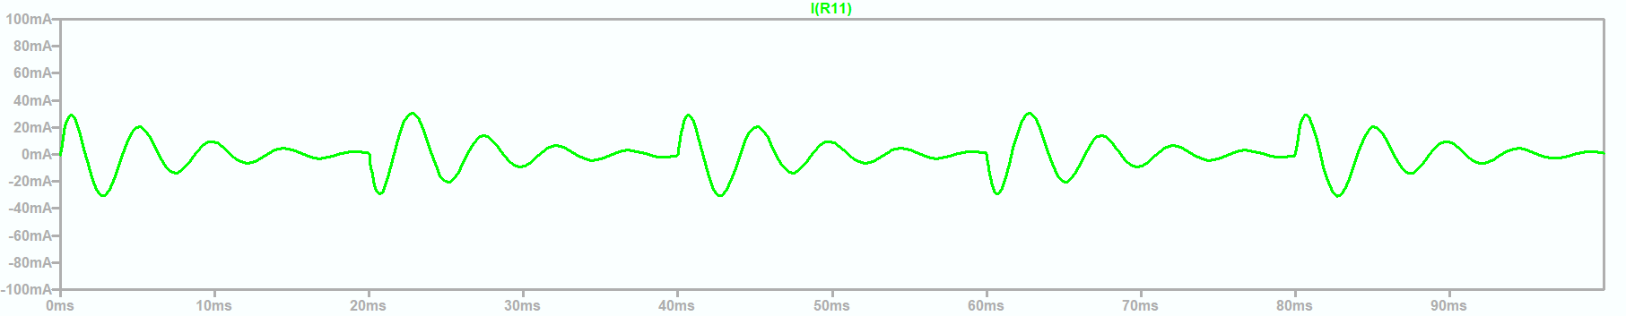
Common Mode Currents (120 ° Mode)
9 ms
12 ms
CM resonant frequency:
211.5 Hz (4.7 ms Period)
36 ms
120 ms
20250607 Inverter CM xxxms.asc

Slide 11
Wrap up

